Slide 1


Internet Basics: Computer Care & Safety
Hana Aden

Slide 2
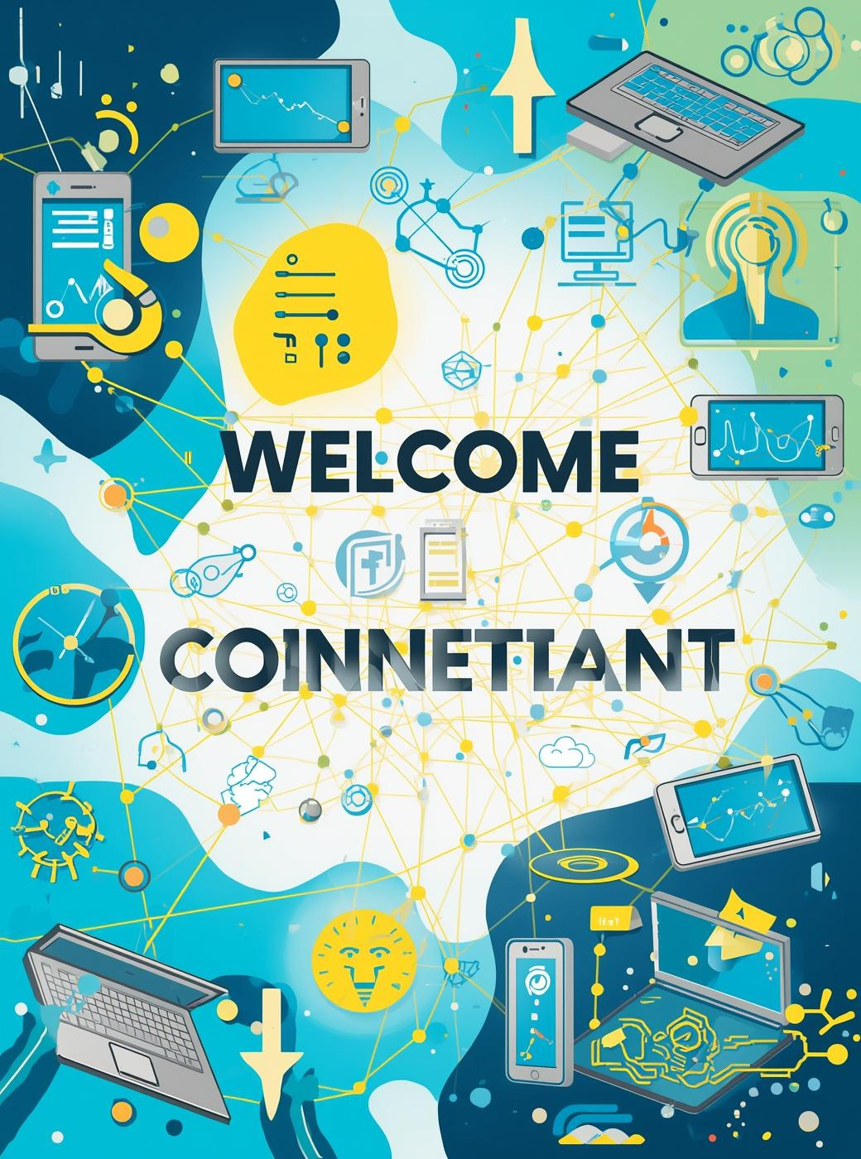
Internet Connectivity and Computer Health
Importance of Digital Connectivity
Staying connected enhances productivity
Understanding Your Devices
Proper care ensures longevity
Practical Skills for Safety
Essential for effective computer use

Slide 3


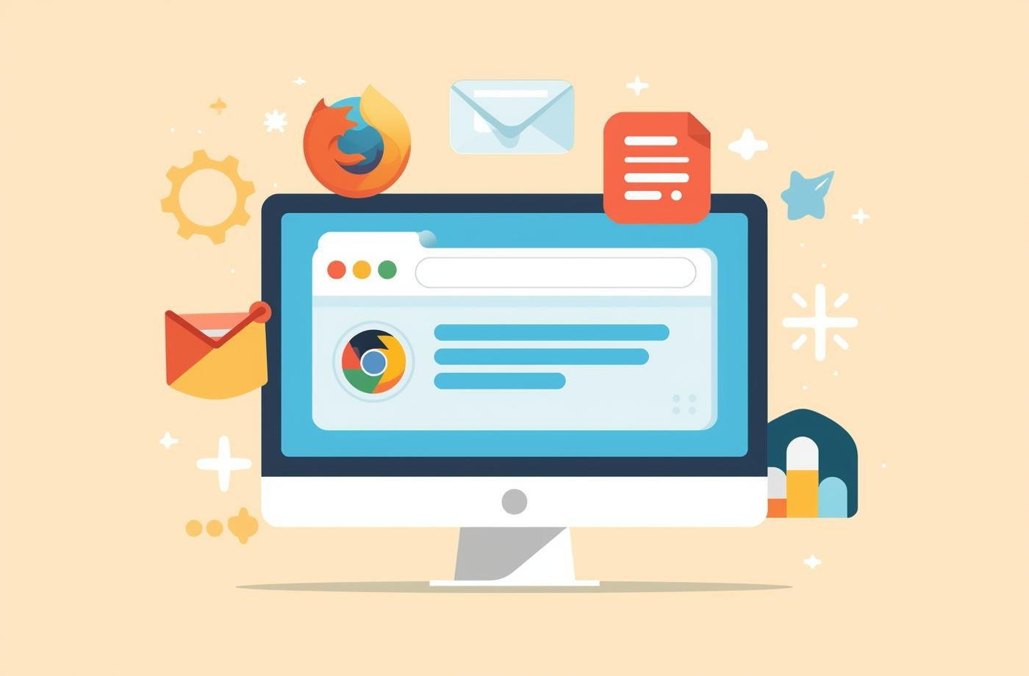
Internet Basics: Understanding Browsers and Uses
Internet
Browsers
Features
The Internet is a global network connecting devices.
Web browsers allow users to navigate the Internet easily.
Key features enhance browsing efficiency and organization.

Slide 4



Introduction to Email and Its Features
Purpose
Features
Uses
Email is a vital communication tool today.
Key elements enhance user experience and organization.
Essential for education, work, and personal correspondence.

Slide 5



Online Safety Essentials: Protecting Yourself Online
Importance
Passwords
Sharing
Online safety helps avoid identity theft risks.
Use strong, unique passwords for all accounts.
Avoid sharing personal info publicly on platforms.

Slide 6
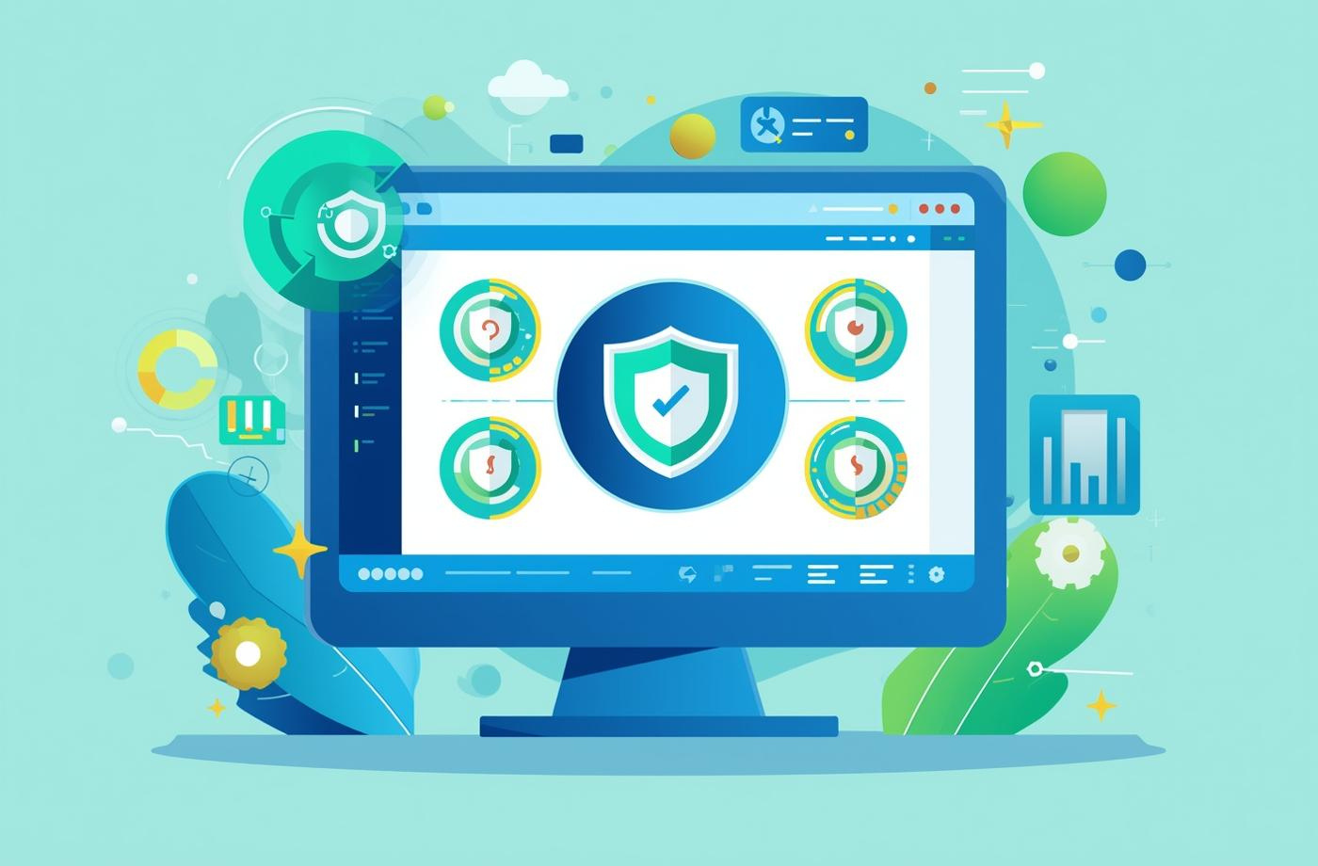
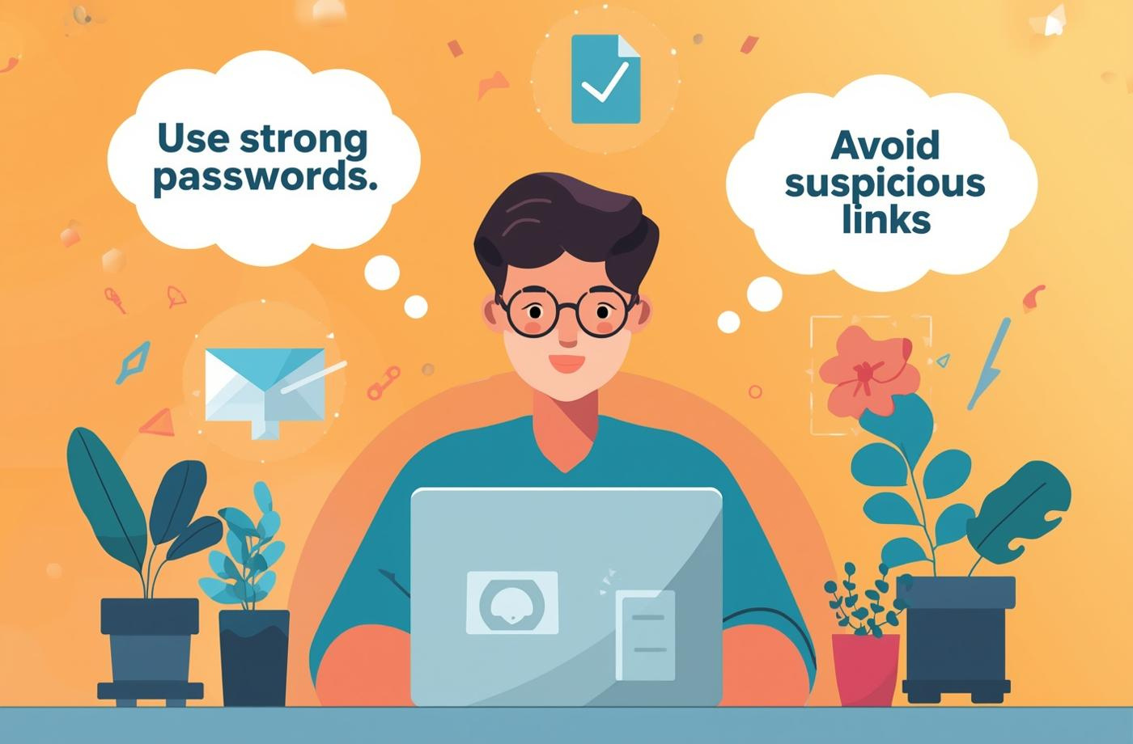

Online Safety: Protecting Your Digital Experience
Antivirus
Browsing
Children
Regularly update your antivirus software for protection.
Practice safe browsing habits to avoid threats.
Ensure children access the internet in safe environments.

Slide 7

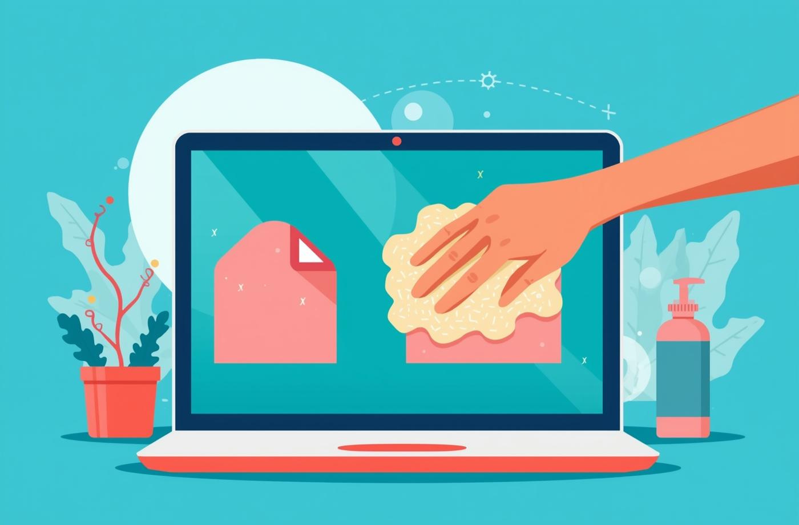
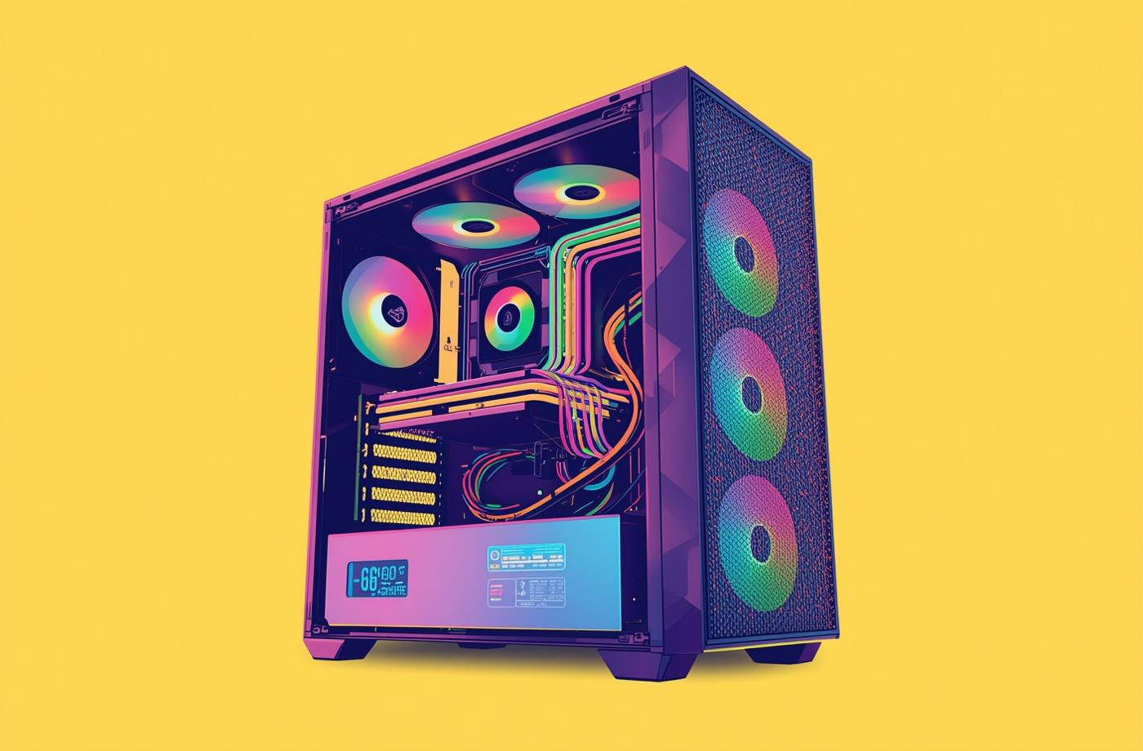
Essential Tips for Hardware Care
Cleaning
Ventilation
Handling
Regular cleaning extends component longevity and performance.
Ensuring airflow prevents overheating and damage.
Gentle handling maintains device integrity and function.

Slide 8
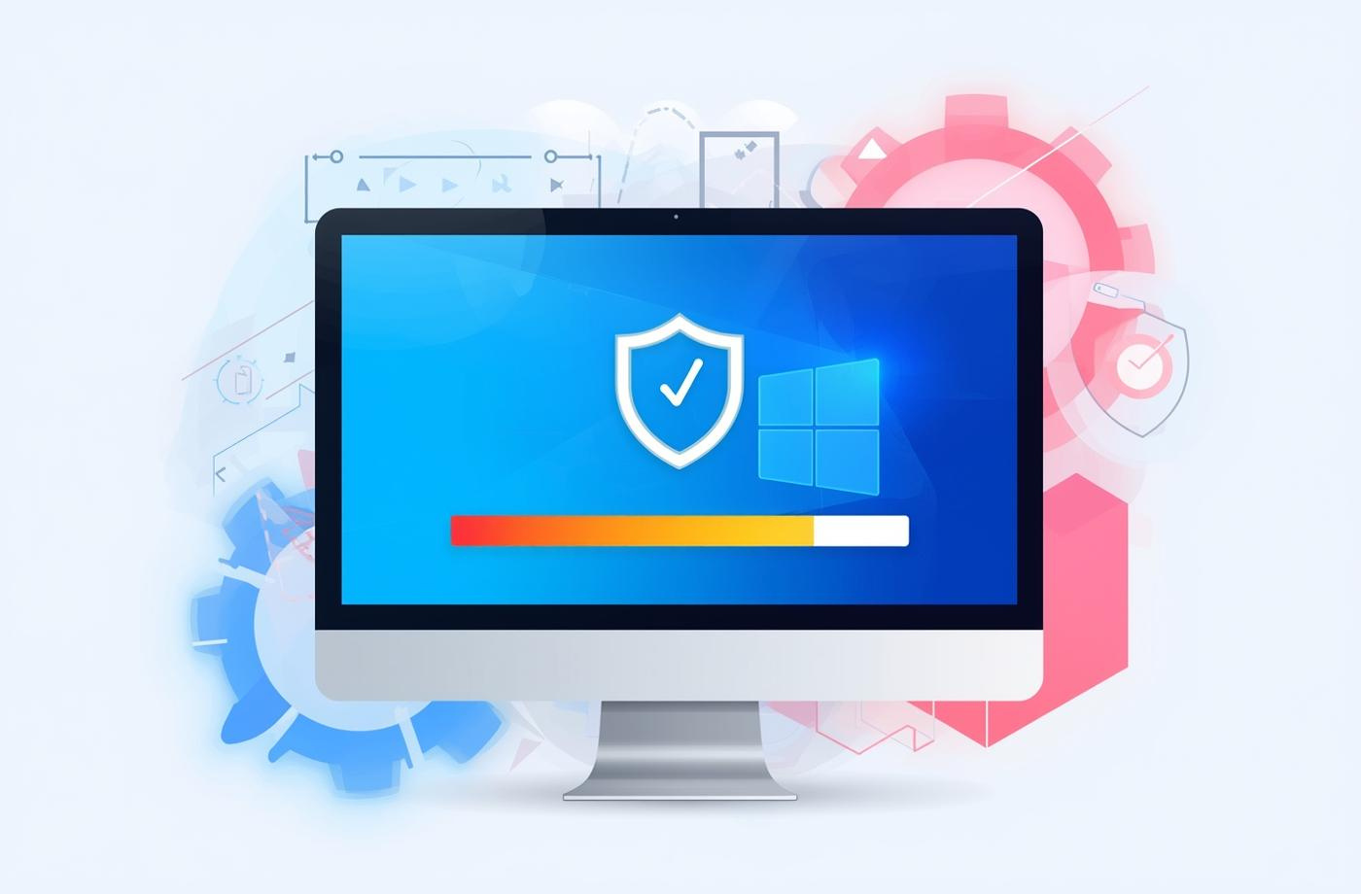
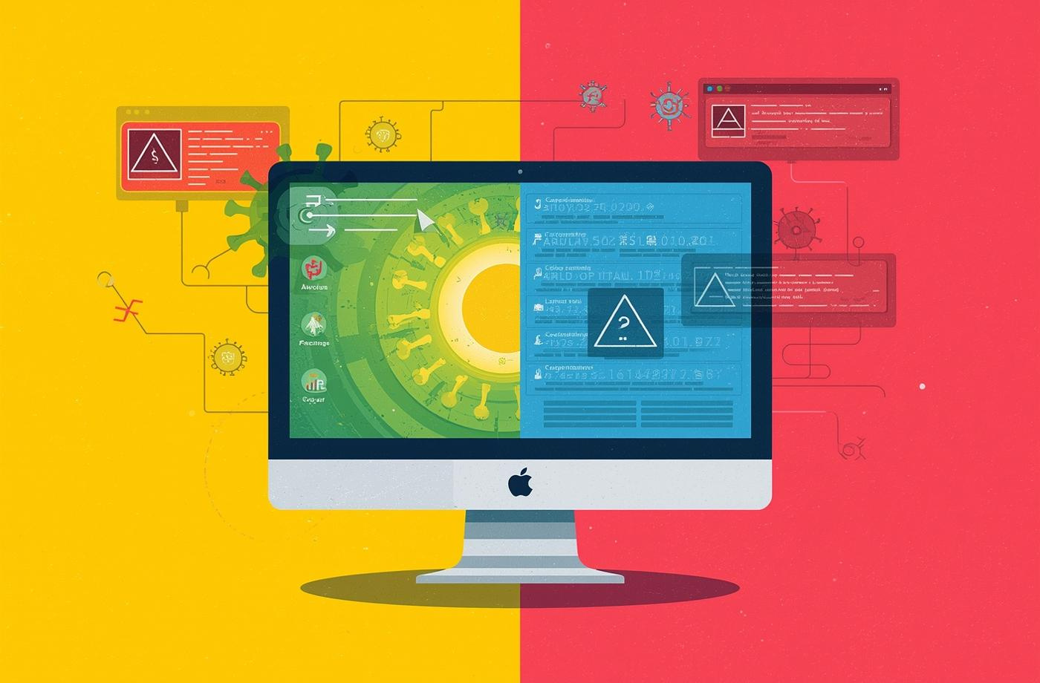

Virus Protection and Scanning Essentials
Basics
Scheduling
Consequences
Understanding essential virus protection measures is crucial.
Regular scans help maintain optimal computer health.
Virus infections can lead to data loss and errors.

Slide 9
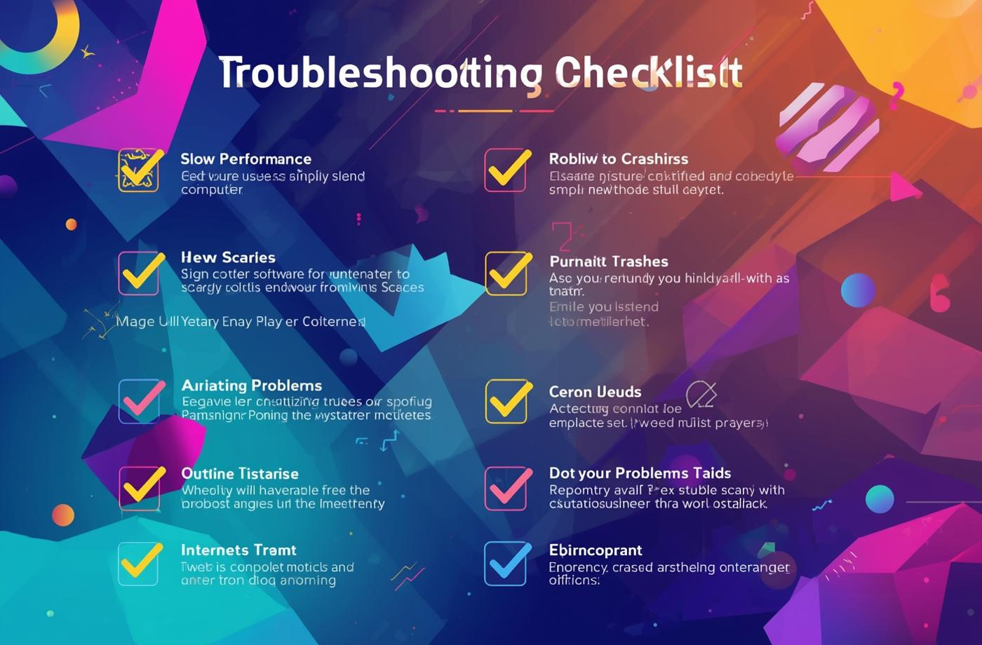

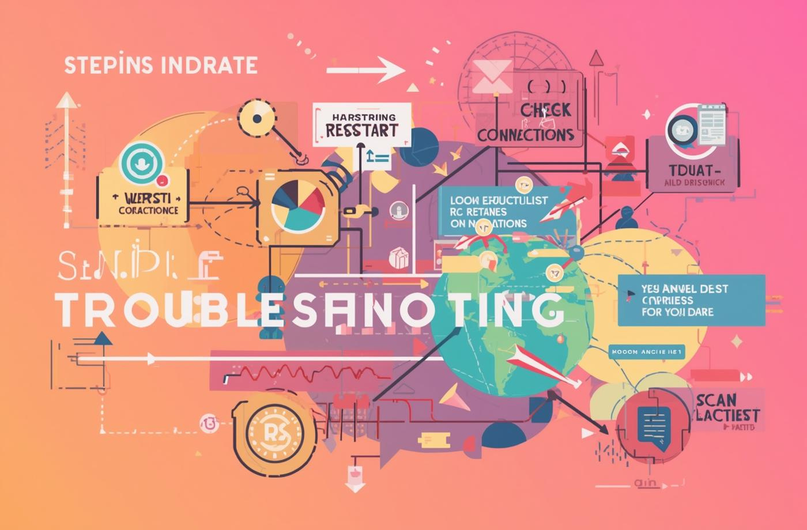
Troubleshooting Common Computer Issues and Steps
Slow
Update
Check
Restart the computer to clear temporary issues.
Ensure software is up-to-date for optimal performance.
Verify connections to resolve internet or hardware problems.

Slide 10
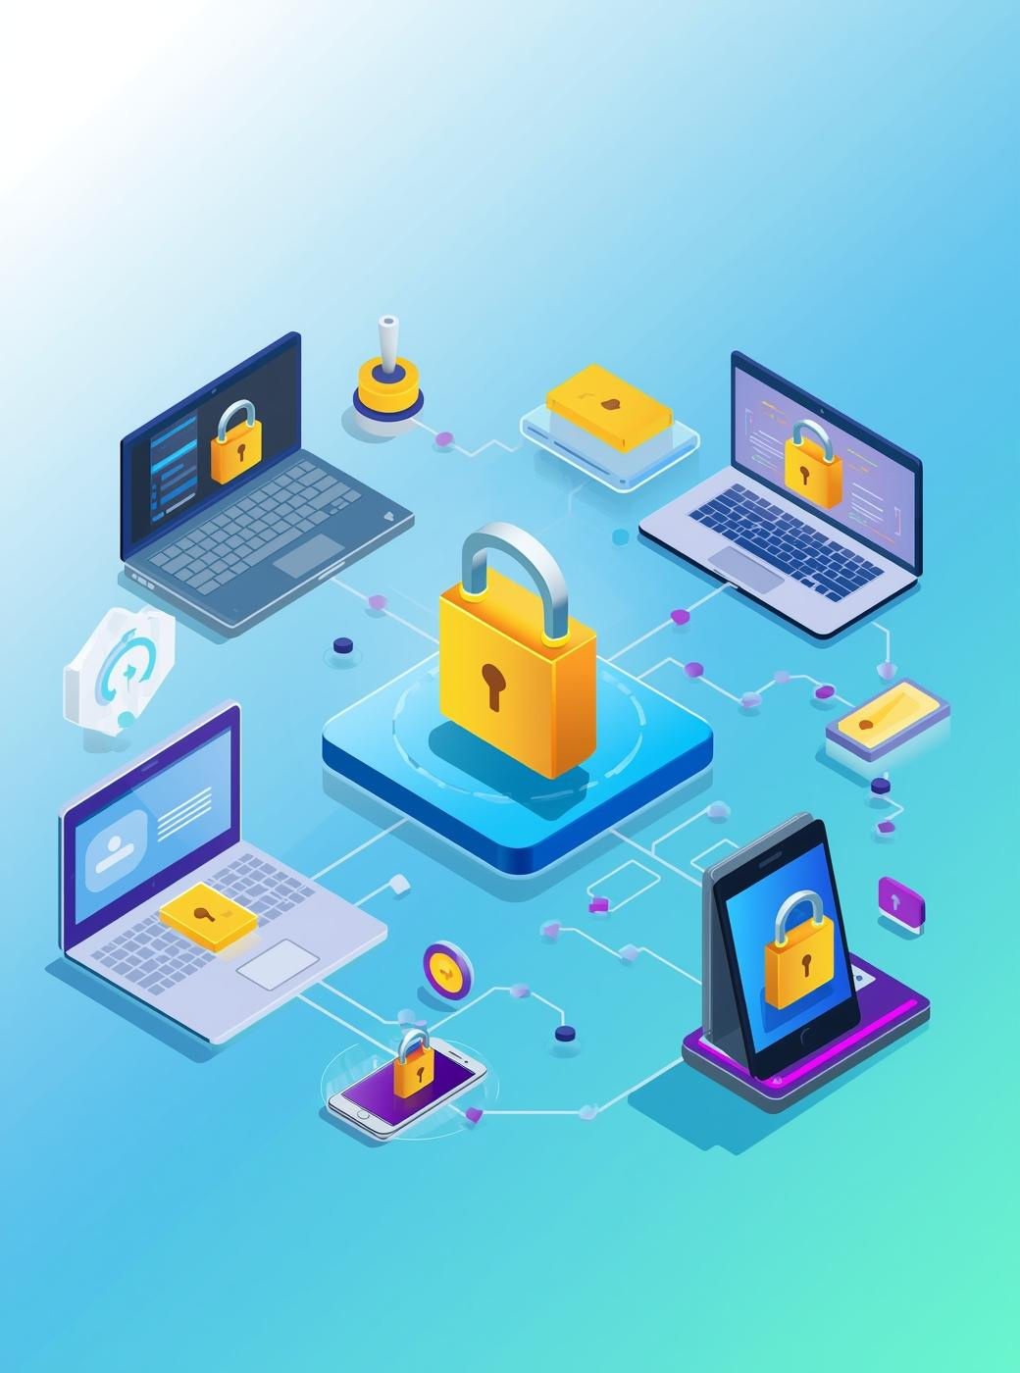
Summary and Next Steps
Internet Tools and Safety
Understanding their importance
Practical Computer Care Tips
Maintaining your hardware
Troubleshooting Techniques
Solving common issues

